Slide 1
Mr. Ulcena
6th - 8th Math
Week at a Glance 01/04/2022 - 01/07-2022

Slide 2
Welcome back to school class of 2021-2022
WAG=WEEK AT A GLANCE
Week at a glance (WAG) is designed to give parents a brief idea of what their child is learning at school. It will have the subject standards (Georgia Standards of Excellence), the main topics covered, links to videos and worksheets.
We encourage parents to review this presentation and stay informed on the weekly learning objectives.
WAGS are subject to change according to student mastery.

Slide 3
Math standards
6th Grade
Unit 4
Rational Exploration: Number and Their Opposites
Priority Standards
6.NS.5
6.NS.7a-d
6.NS.8
Big Ideas:
Understand and use positive and negative numbers to describe real-world situations.
Understand ordering and absolute value of rational numbers.
Solve real-world problems by graphing points in all four quadrants of the coordinate plane.
Learning Target:
I can correctly add and subtract positive and negative numbers.
Success Criteria:
Students correctly use a number line to solve each problems at 80% rate.
7th Grade
Unit 4
Geometry
Priority Standards
7.G.4
7.G.5
7.G.6
Big Ideas:
Solve real-world and mathematical problems involving: angle measure (7.G.5); area, surface area, volume of 2D and 3D objects (7.G.6); and area and circumference of circles.
Learning Target:
I will correctly use the right formula to solve the measurement of each geometry shapes..
Success Criteria:
Students correctly use formula to find the area and circumference of a shape.
8th Grade
Unit 4
Solving Systems of Equations
Priority Standard
8.EE.8a-c
Big Idea:
Analyze and solve pairs of linear equations (Systems of linear equations).
Solve real-world and mathematical problems leading to two linear equations in two variables.
Learning Target:
I will identify and use the 3 methods of system of equations (graphing. substitution method. elimination method).
Success Criteria:
Students will correctly solve system of equations the same way as solving equations with one variables..

Slide 4
Monday 6th Grade Rituals and Routine review 7th Grade Rituals and Routine review 8th Grade Rituals and Routine review | Tuesday 6th Grade Understand and use positive and negative numbers to describe real-world situations. 7th Grade Solve real-world and mathematical problems involving: angle measure (7.G.5); area, surface area, volume of 2D and 3D objects (7.G.6); and area and circumference of circles. 8th Grade Analyze and solve pairs of linear equations (Systems of linear equations). Solve real-world and mathematical problems leading to two linear equations in two variables. | Wednesday Small Group/Remediation | Thursday Prodigygame.com– ALL grade level | Friday Assessment/ PBIS (Positive Behavioral Interventions and Support program)

Slide 5
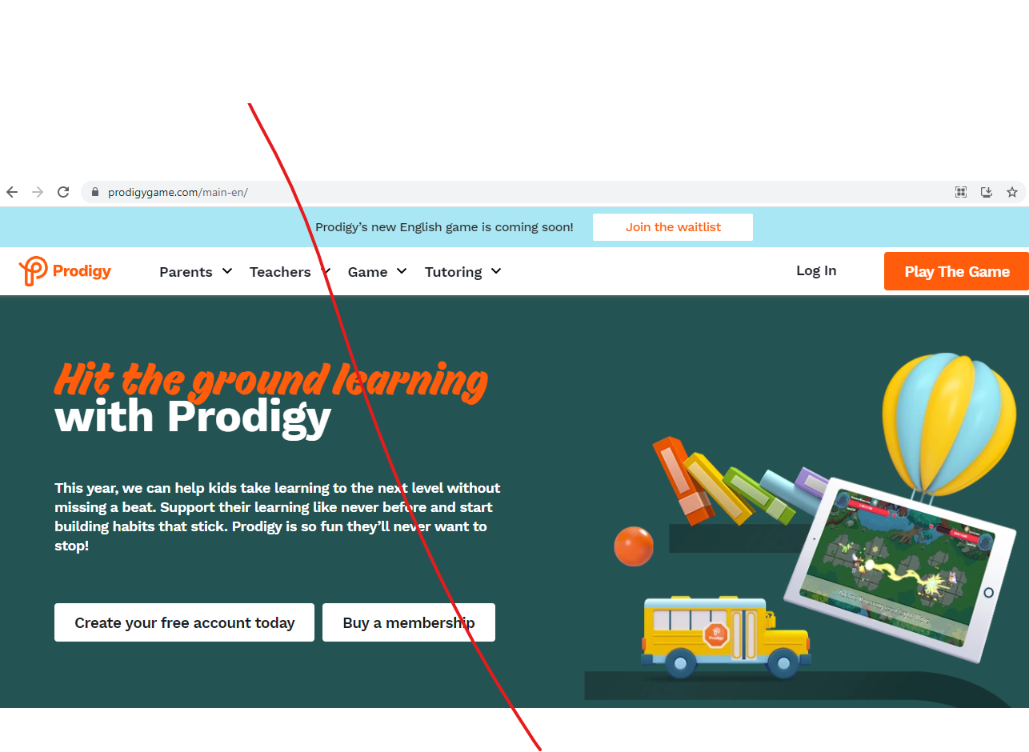

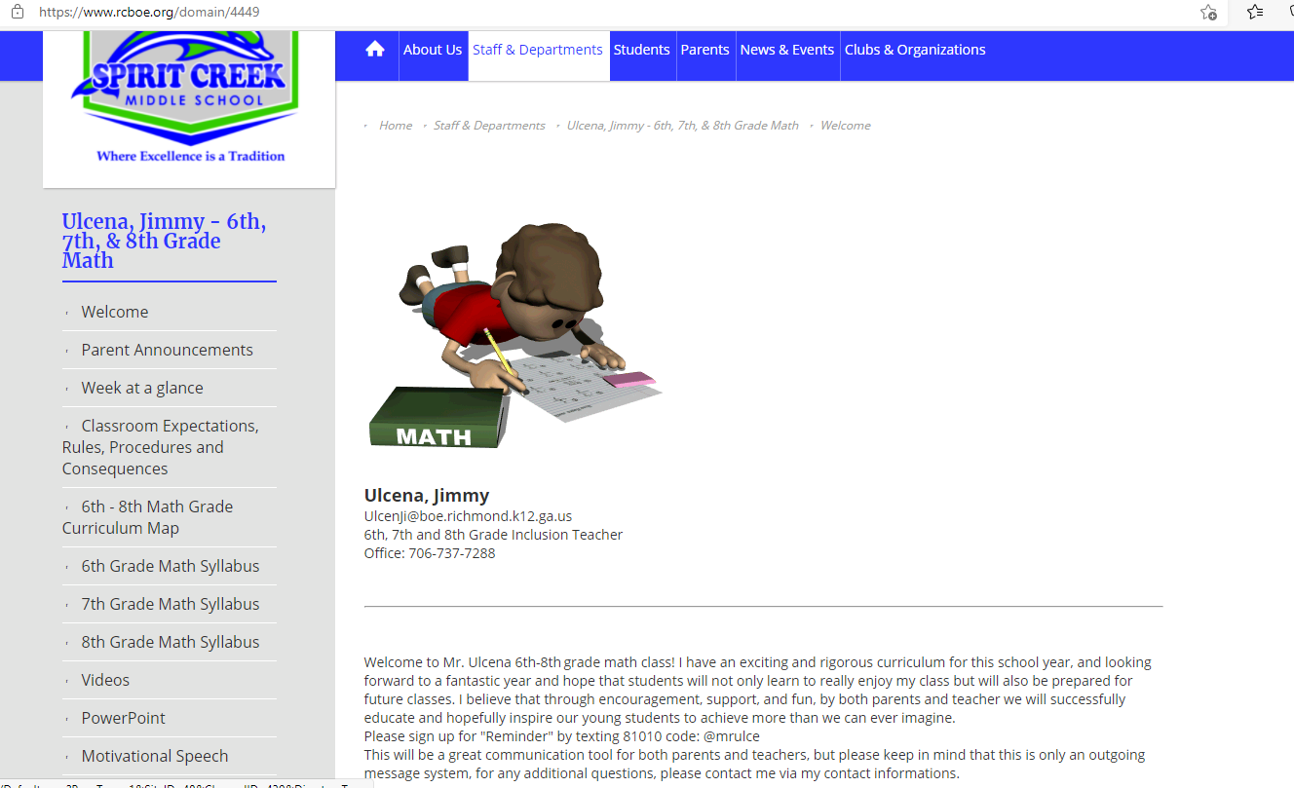
math Resources
For additional resources and weekly PowerPoint and videos click on link to Mr. Ulcena Teacher’s Page
https://www.rcboe.org/domain/4449
Khan Academy
https://www.khanacademy.org/
Prodigygame.com
https://www.prodigygame.com/main-en/
Welcome to EngageNY
YouTube.com
https://www.engageny.org/resource/grade-6-math-introduction-integers
7th Math MGSE7 G 6 Video - YouTube

